Slide 1
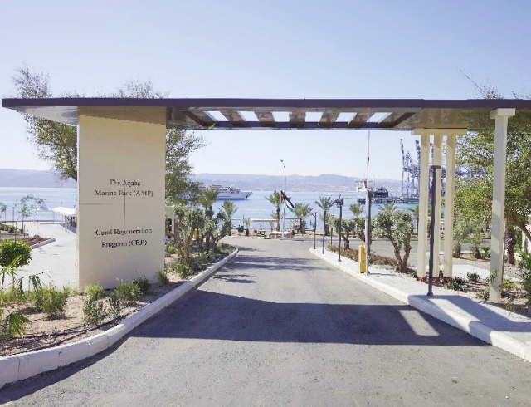
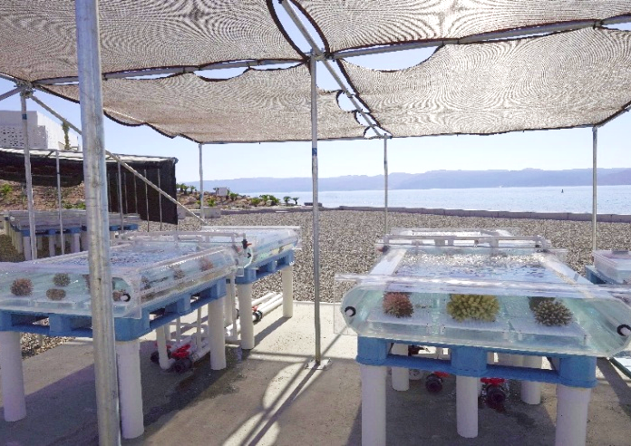
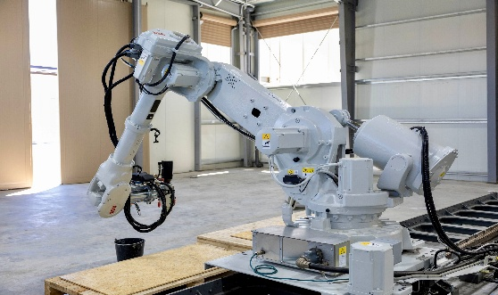

VOYACY REGEN PARTNERS WITH JORDAN TO LAUNCH FIRST OF ITS KIND REEF REGENERATION HUB
On June 9th at UNOC3, Voyacy Regen and The Kingdom of Jordan announced their partnership to launch a new Blue Technology Innovation Hub in Aqaba.
This Hub is a nexus of action implementing Voyacy’s multi-disciplinary solution
Voyacy and Jordan have mobilized a pioneering coral propagation farm and deployed a commercial scale 3D concrete print facility
The Aqaba initiative is bringing together leading Blue Tech players to demonstrate how technology will rebuild and maintain coral reefs at a commercial scale across the globe.
Aqaba Marine Park Innovation Hub
Coral Farm
Best-in-class 3D Printing Facility

