Slide 1

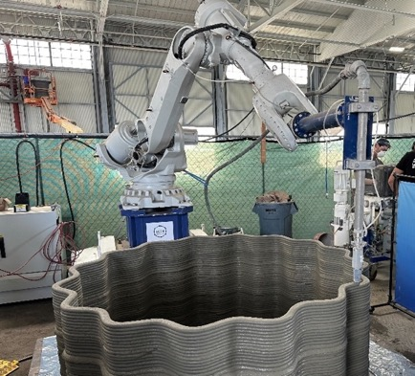
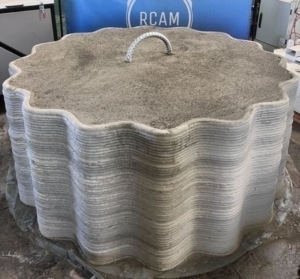
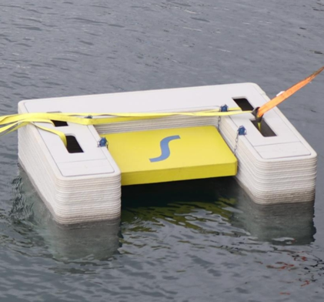

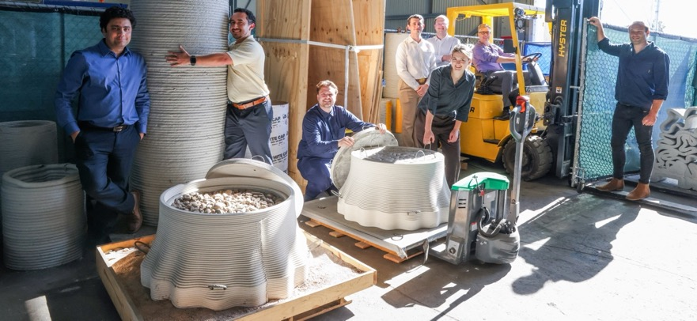
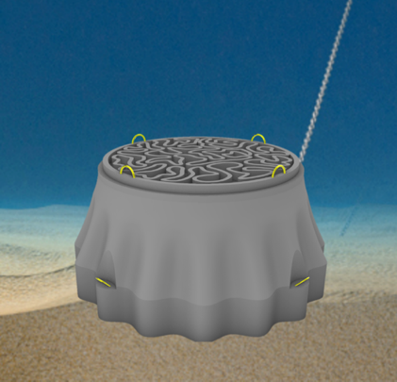
Mission: Sperra is establishing a new era of automated marine construction that delivers offshore energy and coastal resilience solutions worldwide.
Key Innovation:
3D Concrete Printing
Sperra uses 3DCP technology with local materials to radically reduce costs, minimize waste, and automate construction while ensuring superior structural integrity.
Product Portfolio
Floating solar and offshore wind anchors
Solar canal structures
Port infrastructure solutions
Subsea pumped hydro energy storage
1

