Slide 1
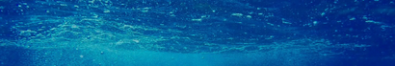
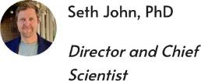
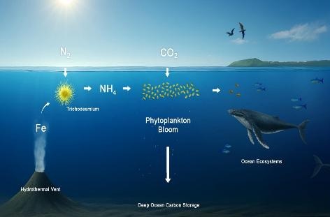


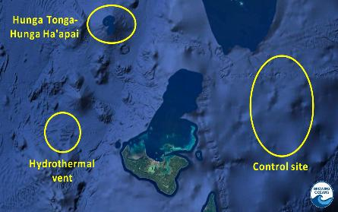
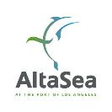
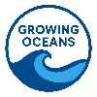
Growing Oceans
Scientific Research for Climate Solutions that Scale
Our Leadership Team
Mission
Mimicking how nature stimulates ocean photosynthesis.
Safe, durable, gigaton-scale marine carbon dioxide removal.
Revitalizing ocean ecosystems.
Research ‘toolbox’
Natural analog study of Tonga hydrothermal vents.
Biogoechemical profiling of South Pacific nitrogen-fixation.
Ecosystem impact measurements.
An AltaSea Initiative

