Slide 1
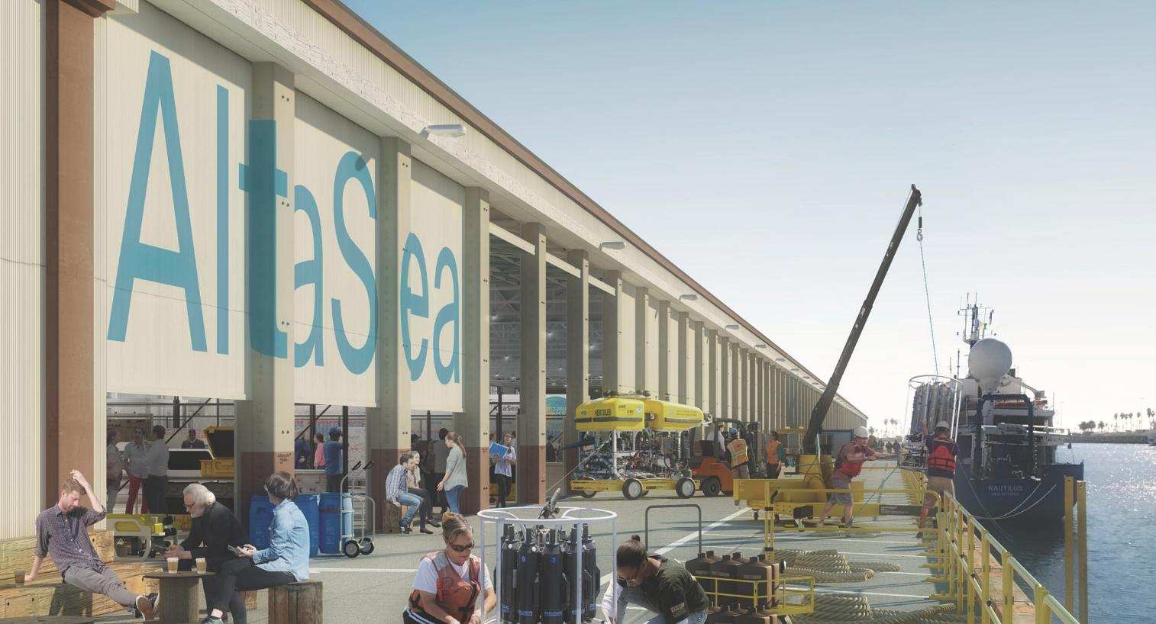

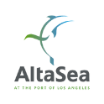
The AltaSea Deep Blue Decade Initiative
Rapid Scaling of Ocean Climate Solutions Worldwide

Slide 2

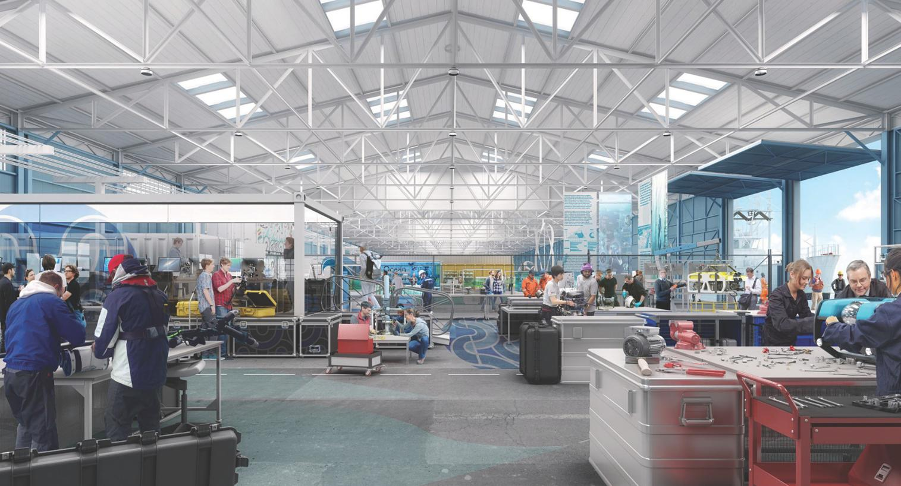
WHY THIS INITIATIVE MATTERS
ALTASEA’S VISION
A testbed-to-commercialization ecosystem for ocean innovations in technology, policy, finance, workforce development, and education, replicated globally for scale.
THE URGENCY
Climate change solutions must scale rapidly—our oceans hold the key.
FUNDING IMPERATIVE
A five-year initiative backed by a strategic global consortium.
CALL TO ACTION
A collective investment of $25m (over 5 years) will directly accelerate the deployment of ocean climate solutions at scale in at least 6 strategic locations globally.

Slide 3
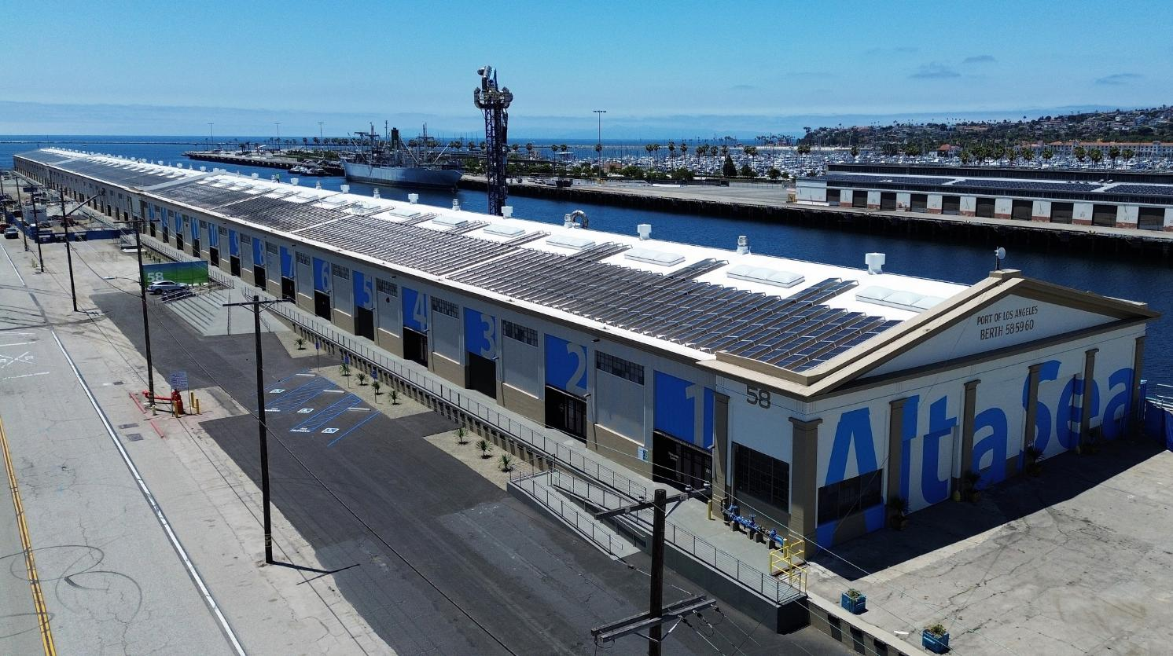

BASED ON THE ALTASEA MODEL OF UNPARALLELED RESOURCES & ASSETS
AltaSea is a 35-acre world-class oceanographic campus with direct access to marine resources and transportation corridors to support ocean-based businesses, research labs, vessels, and blue economy programs.
NEWLY-COMPLETED MAJOR RENOVATION OF HISTORIC PORT FACILITIES
225K +
sq. ft. of indoor facilities and 4,500 linear ft. of dock space
180K
sq. ft. Center of Innovation ($50M+ invested)
180K
sq. ft. solar array producing 2.2 megawatts

Slide 4
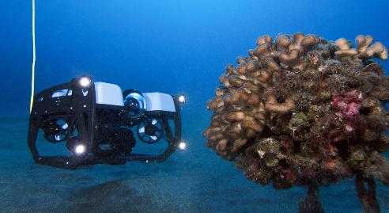
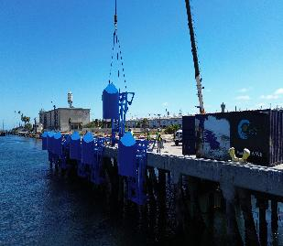
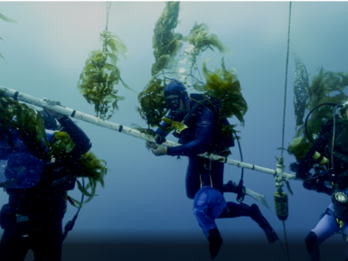
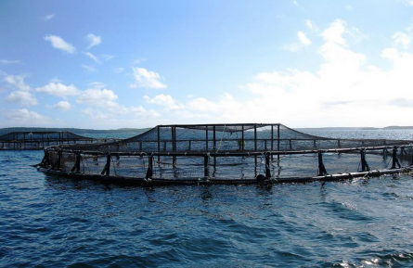
THE ALTASEA DEEP BLUE DECADE INITIATIVE (DBDI)
STRATEGIC FRAMEWORK
THE INNOVATION MODEL
Rapidly moving ocean climate solutions from R&D to full-scale commercialization through piloting and scaling innovations, and training global Blue Economy workforces.
CORE FOCUS AREAS
Sustainable Aquaculture & Fisheries (Emphasizing Seaweeds) for Food Security and Biofuels
Marine Carbon Dioxide Removal (mCDR)
Marine-Based Renewable Energy
Cost-Efficient Green Hydrogen
Robotics & Automation for Ocean Sustainability
Blue Tech Solutions for Protective Coastal Infrastructure
Research Technologies to Protect Marine Protected Areas

Slide 5
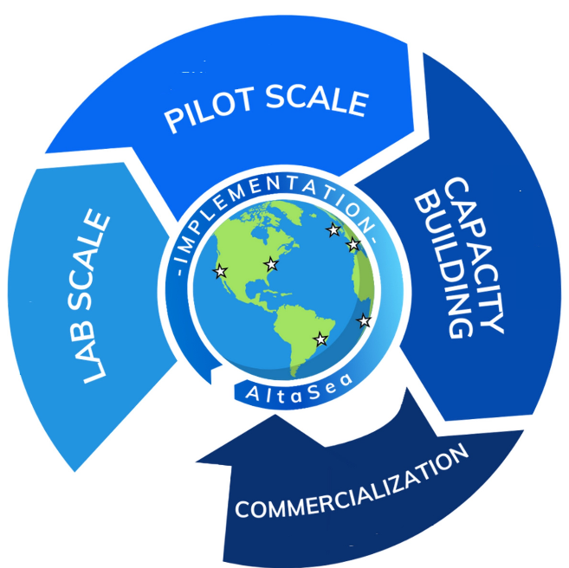
DBDI: HOW IT WORKS
Phase 1: Discovery, Lab Scale & Planning
Phase 2: Pilot Implementation: Launching pilot economic development, workforce training, research, and education projects with ocean community partners
Phase 3: Scale-Up and Capacity Building: Scaling infrastructure and talent, leading to global commercialization
Phase 4: Commercialization: Using DBDI hubs and investment partners to deploy solutions at scale

Slide 6
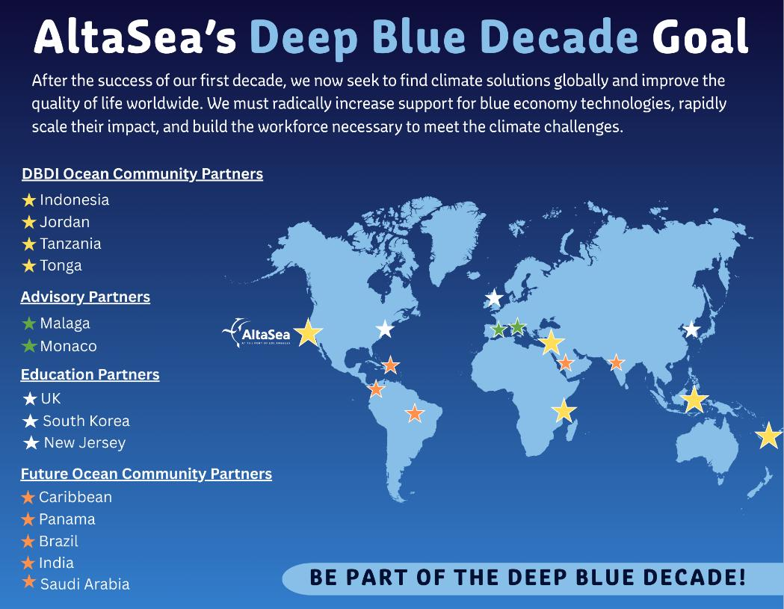

Slide 7










A FIVE-YEAR ACTION PLAN
2027-2028
PHASE 2: PILOT IMPLEMENTATION
2029
PHASE 3: SCALE-UP COMMERCIALIZATION
Launch pilot-scale economic development, workforce training, research, and education projects in each DBDI ocean community to implement aquaculture, ocean carbon removal and/or renewable energy.
Scale ocean-based climate interventions to commercial levels; establish global permitting frameworks; expand Blue Economy workforce by 1,000+ specialists.
2025-2026
PHASE 1: DISCOVERY & PLANNING
2030 AND BEYOND
Expand DBDI network and global commercialization of blue economy solutions.
Launch DBDI and conduct full assessment of DBDI international ocean communities in Indonesia, Tanzania, Jordan, and Tonga; co-develop implementation plans and workforce development programming.

Slide 8

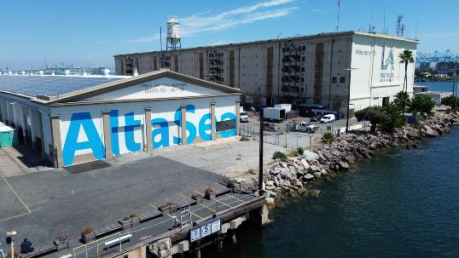
NEXT STEPS & TIMELINE
LAYING THE FOUNDATION
SCALING & INFRASTRUCTURE DEVELOPMENT
Early 2027: Launch Phase 2 implementation plans and pilot projects in Indonesia, Tanzania, Jordan, and Tonga
Early 2027: Launch Phase 1 process with new DBDI ocean communities (every year going forward)
Late 2027: Secure seed funding for companies in DBDI ocean communities
September 2025: Official DBDI launch at UN Climate Week, New York
December 2025: Secure initial funding to kickstart pilot projects
2025
2026
2027
PILOT & CAPACITY EXPANSION
Q1-4 2026: Launch Phase 1 discovery process in DBDI ocean communities in Indonesia, Tanzania, Jordan, and Tonga
Q2-4 2026: Develop new workforce training resources
Q4 2026: Complete Phase 1 in first group of DBDI ocean communities; publish policy reports on aquaculture, renewable marine energies, and marine carbon dioxide removal (mCDR) integration in California

Slide 9

NEXT STEPS & TIMELINE
FULL-SCALE GLOBAL IMPACT
2029: Launch Phase 3 in Indonesia, Tanzania, Jordan, and Tonga, leading to commercial deployment of aquaculture, ocean carbon removal, and/or renewable energy in at least five DBDI ocean communities (including LA)
2030: Achieve global commercialization of ocean climate solutions, ensuring long-term impact
COMMERCIALIZATION & POLICY IMPLEMENTATION
2028
2029-2030
Now is the time to act—be a part of the solution in scaling ocean innovations globally!
Early 2028: Launch Phase 2 process with at least three new DBDI ocean communities
Mid-2028: Establish international policy frameworks for mCDR regulation
Late 2028: Expand the global affiliate network to 15 ocean communities worldwide
Late 2028: Expand the Blue Economy workforce by 500+ trained specialists per year

Slide 10
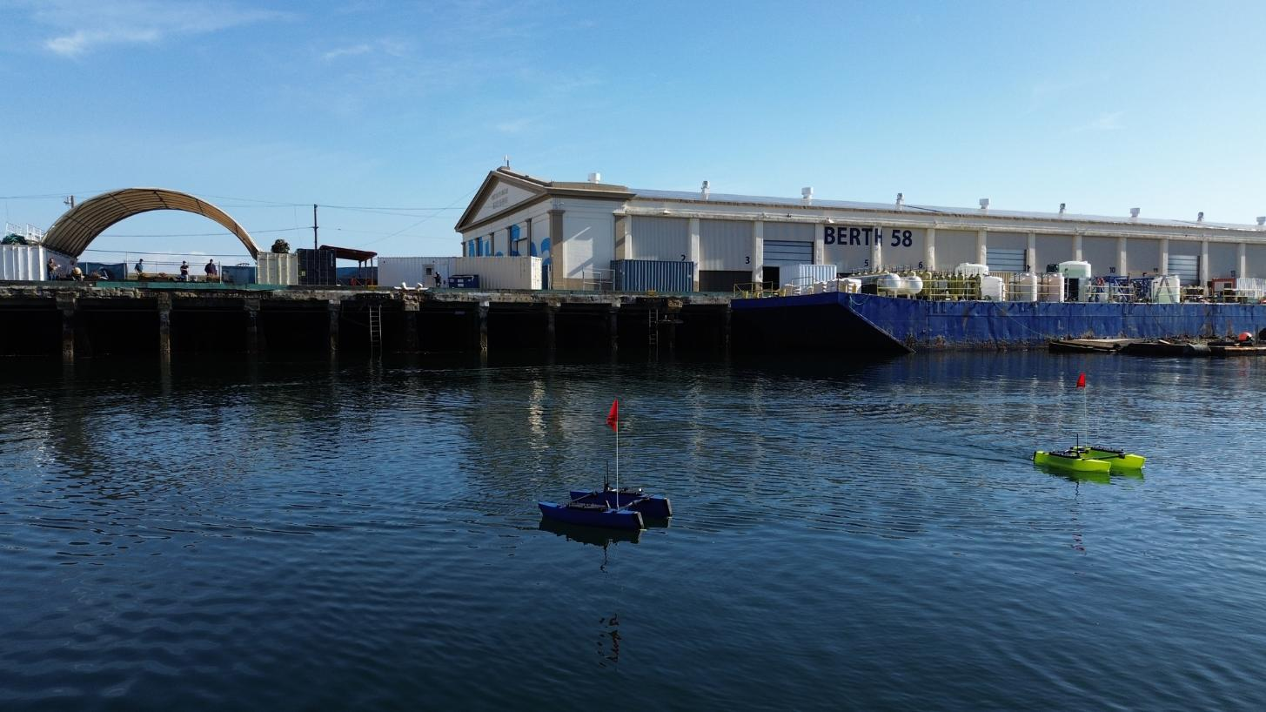

Appendix A
AltaSea: A Leader in Ocean
Climate Solutions

Slide 11
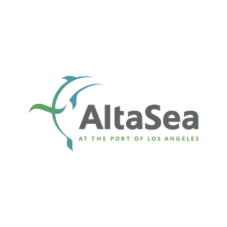
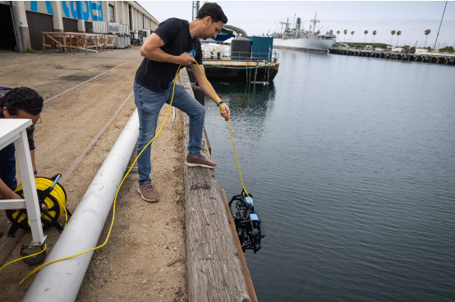
THE ALTASEA FACILITY
KEY FUNCTIONS
Proof-of-concept R&D, business development, workforce training, and education hub (already being replicated in Kearny, NJ)
Dedicated ocean-access space for research, commercial, workforce, and education partners
Two new wet/dry ‘Blue Economy Research Laboratories’ to support student researchers and others seeking temporary R&D facilities
Public policy initiatives, using California’s environmental leadership to scale up rapidly in the world’s fifth largest economy (on-going)
Workforce development initiatives to train the unique skills needed for ocean innovation and scale-up (on-going)
Connection to 5+ global ocean communities to expand DBDI

Slide 12
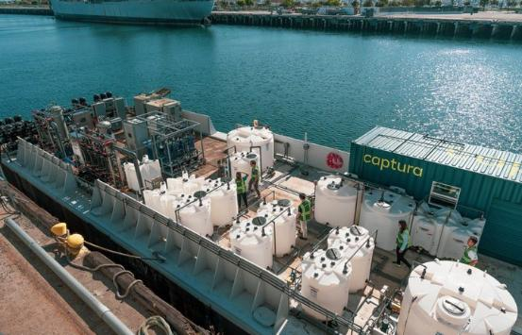
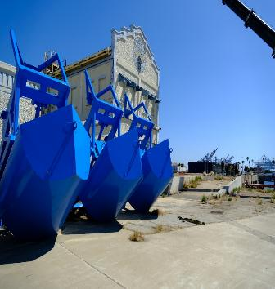
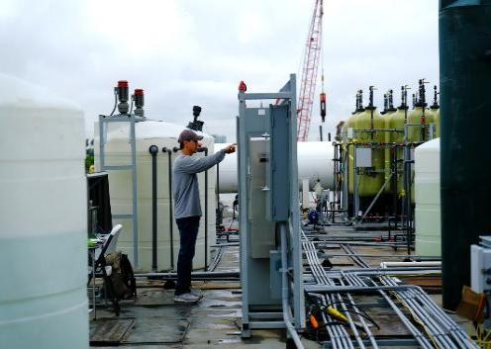
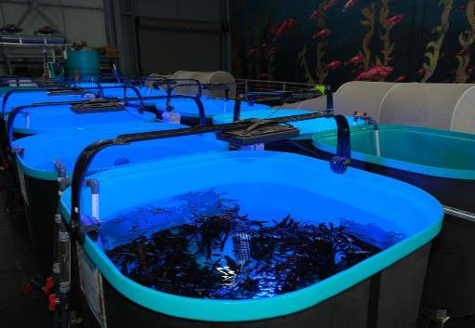

STRONG PROGRAMS & PARTNERS
TRACK RECORD FOR SUPPORTING DEMONSTRATIONS AND SCALE-UP:
Captura (CalTech/USC)
Eco Wave Power
Equatic (UCLA)
Kelp Ark (USC)
Facilitated 100x scaleup for this X-Prize Finalist to capture 100 tons of CO2 from the ocean annually at AltaSea.
Successfully obtained all necessary permits to implement California’s first wave technology demonstration.
Connected the organization with investors to support global expansion and facilitated LA testbed.
Guided the launch of Kelp Ark, including the development of the first seaweed seed bank and a state-of-the-art kelp lab at AltaSea.

Slide 13
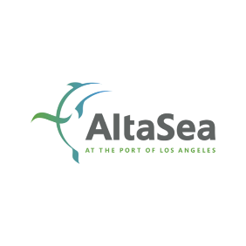
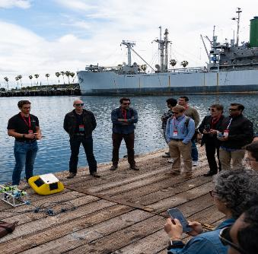
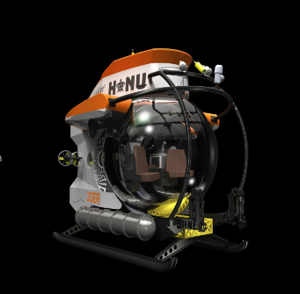
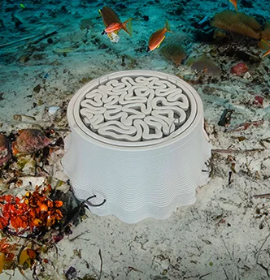
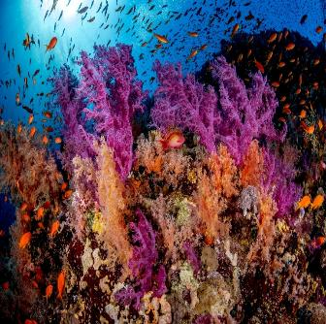

STRONG PROGRAMS & PARTNERS
TRACK RECORD FOR DEVELOPING AND SCALING BLUE TECH SOLUTIONS FOR PROTECTING COASTAL INFRASTRUCTURE AND MARINE PROTECTIVE AREAS:
Braid Theory
DOER Marine
Sperra
Voyacy Regen
Braid Theory is a vertically integrated venture advisory firm that supports science and engineering-led companies operating in the Blue Economy through accelerator, incubator, pilot to market, and global landing pad programs.
AltaSea is a key collaborator that helps DOER Marine, led by Sylvia Earle (President) and Liz Taylor (CEO), extend their reach beyond engineering into public education and ecosystem-wide ocean impact.
Sperra operates a 3D‑concrete printing R&D lab where it pioneers offshore renewable energy and subsea storage infrastructure while leveraging AltaSea’s marine access.
Voyacy’s Regen, led by Philippe and Ashlan Cousteau, and AltaSea both aim to harness science, technology, and entrepreneurship to restore ocean health and drive sustainable solutions.

Slide 14
Appendix B
DBDI OCEAN COMMUNITIES:
The Next Four International AltaSea Hubs

Slide 15
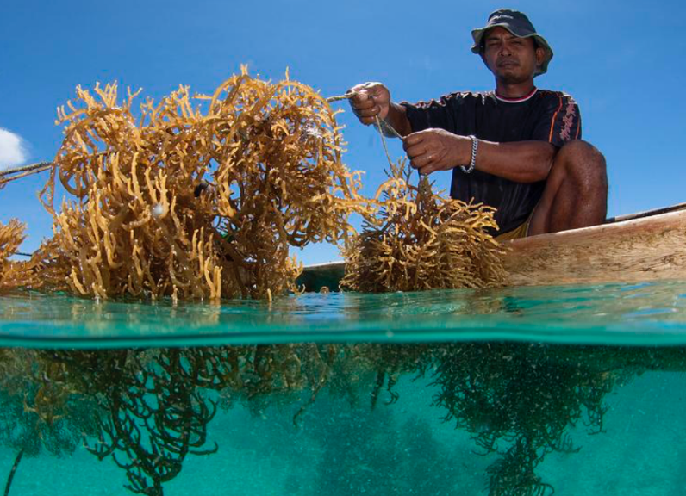
DBDI INTERNATIONAL OCEAN COMMUNITY PARTNERS
Location: Indonesia
Priority Blue Economy Focus Area(s): Aquaculture, with a focus on Seaweed
Indonesia is a major global player in seaweed aquaculture, particularly for Eucheumatoid seaweed used in carrageenan production as a thickener. The industry provides livelihoods for thousands of coastal families and contributes significantly to the national fisheries output.
While Indonesia leads in production volume, challenges remain in optimizing economic value and ensuring sustainability. AltaSea is in discussions with Indonesian officials to deploy the DBDI System Thinking approach to resolve these issues.
Resources for a DBDI Hub include government land to build a facility, support from specific philanthropic supporters, and potential for partnership with Pegasus Capital Advisors on their development of a new eco-tourism resort that will feature onsite aquaculture.

Slide 16
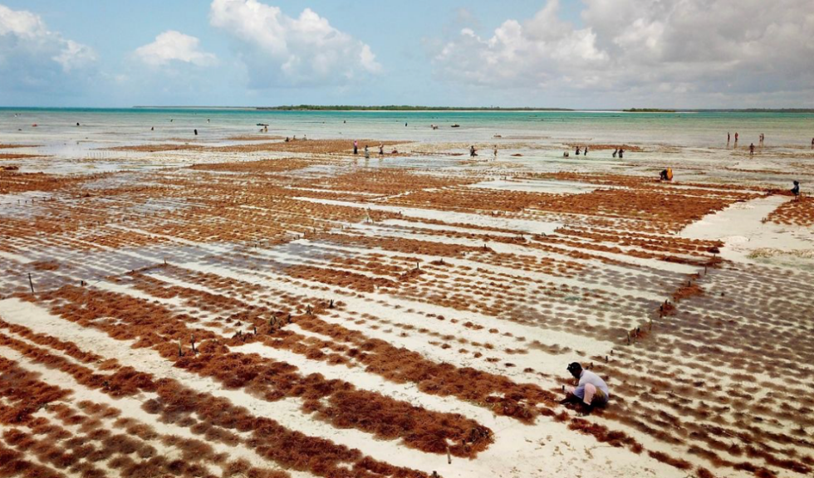
DBDI INTERNATIONAL OCEAN COMMUNITY PARTNERS
Location: Zanzibar, Tanzania
Priority Blue Economy Focus Area(s): Aquaculture, with a focus on Land-Based Production
AltaSea, in partnership with Kelp Ark and the United Nations Development Programme (UNDP), is exploring a collaboration with the Government of Zanzibar to support scaling up of their aquaculture industry, with an initial focus on the seaweed sector.
The initiative seeks to diversify Zanzibar's economic opportunities derived from seaweed including applications for biostimulants, nutraceuticals, and alternatives to packaging/plastics, among others.
The initiative leverages recently secured UN & World Bank resources, valued at ~USD$50 million (combination of grants and loans).
Zanzibar’s seaweed sector employs over 23,500 farmers, 80% of whom are women.

Slide 17
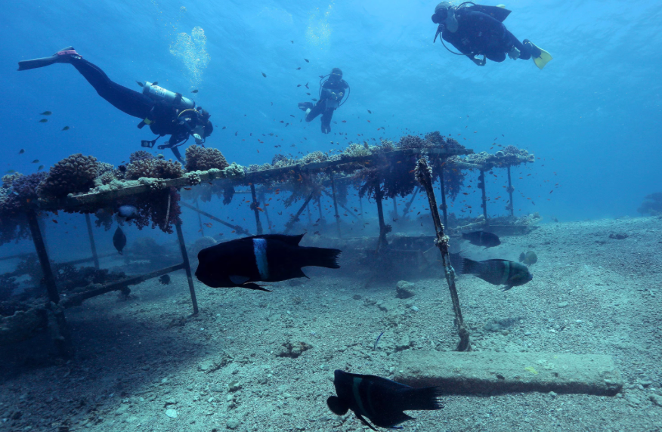
DBDI INTERNATIONAL OCEAN COMMUNITY PARTNERS
Location: Aqaba, Jordan
Priority Blue Economy Focus Area(s): Aquaculture, with a focus on Coral Reef Restoration
Jordan’s only seaport is emerging as a key Middle Eastern logistics and innovation hub. With multimillion-dollar investments in infrastructure, sustainability, and smart port systems, Aqaba is aligning with global blue economy leadership.
Voyacy Regen has partnered with the Royal Court of the Hashemite Kingdom of Jordan to launch a Blue Economy Innovation Hub in Aqaba, a visionary new project to drive tangible, scalable, commercial solutions to some of the biggest challenges facing the ocean. This Innovation Hub is playing a vital role in regenerating coral reefs, strengthening climate resilience, and promoting the sustainable use of ocean resources. Altasea is joining Voyacy as a strategic partner in helping further develop this first-of-its-kind Innovation Hub bringing its bluetech startup experience and community to this important work.
In particular, AltaSea in partnership with members of their blue tech community, will collaborate with Voyacy to create workforce and community development programs.

Slide 18
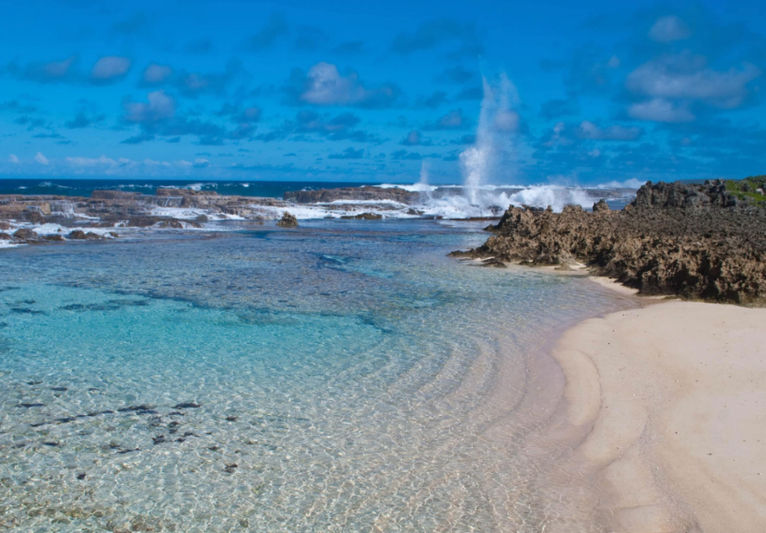
DBDI INTERNATIONAL OCEAN COMMUNITY PARTNERS
Location: Tonga
Priority Blue Economy Focus Area(s): Marine Carbon Dioxide Removal (mCDR), with a focus on Carbon Sequestration
AltaSea consultants are negotiating with the government of Tonga to build a scientific partnership focused on researching natural mechanisms of phytoplankton biomass enhancement and carbon capture recently identified in the Tonga Kermadec Ridge region.
This applied research has the potential to support Tongan goals for climate action, restoration of coastal and marine ecosystems, and workforce and economic benefits for Tongan communities. It will lay the groundwork for future research on phytoplankton-based solutions for carbon sequestration in Tongan waters and carbon revenues generated by validation of sequestration.

Slide 19
Appendix C
DBDI: A SYSTEMS THINKING APPROACH
HOW EACH PHASE
ADVANCES THE MISSION

Slide 20

PHASE 1: DISCOVERY, LAB SCALE & PLANNING
FOCUS: Co-creating Development Strategies, Scientific Foundations, and Policy Frameworks
Facilitating the development of blue economy hubs together with global ocean community partners by conducting evaluations, assessing resources, and co-developing implementation plans and workforce development programming with each ocean community.
Organizing global education initiatives to share research, best practices, and industry insights.
Strengthening DBDI resources by establishing AltaSea as the global testbed, a makerspace featuring state-of-the-art facilities and systems to support aquaculture / ocean biomass products (foods, fuels, bio-stimulants, animal feed), wave/tidal energy, and early-stage marine carbon dioxide removal (mCDR) solutions.
Spearheading policy innovation in California to provide regulatory pathways for ocean-based climate solutions and to integrate ocean carbon removal into state and federal climate policies, helping governments in our global ocean communities to adapt and adopt similar incentives.
Hosting a biennial multi-stakeholder gathering to drive alignment between research, industry, and policymakers.

Slide 21
PHASE 1: DISCOVERY, LAB SCALE & PLANNING
FIRST FIVE YEARS: BENCHMARK DELIVERABLES
✔2025: Launch the Deep Blue Decade initiative; begin ocean community partner evaluations in the first four DBDI international ocean communities.
✔2026: Complete assessments and implementation plans with first four DBDI ocean communities; establish AltaSea as a global testbed; publish policy report on integrating aquaculture, renewable marine energies, and mCDR into California’s climate and business frameworks.
✔2027: Begin ocean community partner discovery and planning in other ocean communities (every year going forward).
✔2028: Establish an international policy working group to standardize relevant regulations.
✔2029: Publish reports on pilot studies and standardized regulations to support next phases of research and development.

Slide 22
PHASE 2: PILOT IMPLEMENTATION
FOCUS: Launching pilot economic development, workforce training, research, and education projects with ocean community partners
Economic Development
Advancing commercialization through investment readiness and financial literacy programming, and piloting development projects co-designed with each DBDI ocean community to accelerate Blue Economy growth.
Catalyzing businesses to operate in each DBDI ocean community and growing a robust innovation economy that promotes entrepreneurship, commercialization of research, and community building.
Research & Development
Modifiable and scalable for each DBDI ocean community
Aquaculture: Developing kelp/seaweed genetics, husbandry, farming, ecology and low carbon agriculture applications; novel anchor/farming technologies for regenerative aquaculture; land-based RAS systems development; ecosystems restoration.
Renewable energy: Wave/tidal, green hydrogen, biofuels.
mCDR: Ocean iron fertilization; ocean alkalinity enhancement; electrochemical CO2 removal; algal sequestration.
Workforce Training
Supporting and advancing career-connected learning initiatives that benefit commercial enterprises and regional workforces, alongside professional development opportunities for teachers and students.
Leveraging Blue Economy career technical education (CTE) resources developed in CA and modifying to meet community needs.
Education
Integrating AltaSea’s educational programming framework into each DBDI ocean community, developing locally-focused supplemental modules to existing K-12 curriculums, and linking students across global communities to share learning experiences.
Increasing social understanding and acceptance of Blue Economy industries, including modeling ecological impacts of ocean interventions and ensuring scientific consensus on best practices.

Slide 23
PHASE 2: PILOT IMPLEMENTATION
FIRST FIVE YEARS: BENCHMARK DELIVERABLES
✔2025: Delivery of first permitted pilot demonstration (EcoWave at AltaSea).
✔2026: Secure permitting approvals for additional pilot projects in California and first four DBDI international ocean communities; develop new training materials for workforce development pilot projects including modifying SMC Career Technical Education (CTE) Aquaculture training certificate for local applications; develop “how to” manuals for global partners in aquaculture, renewable energies, and mCDR.
✔2027: Launch implementation plans and pilot projects in DBDI ocean communities, including aquaculture-focused projects in Indonesia, Tanzania, and Jordan, and a mCDR-focused project in Tonga; begin coordinating global shared-use test beds; establish standardized MRV protocols for ocean carbon removal.
✔2028: Implement strategic plans and pilot projects in new DBDI ocean communities (every year going forward); train 20+ local specialists in relevant focus area of each ocean community (every year going forward); complete pilot projects in Indonesia, Tanzania, Jordan, and Tonga; launch pilot projects with new DBDI ocean communities (every year going forward).
✔2029: Establish global permitting framework for commercial ocean carbon removal.

Slide 24
PHASE 3: SCALE-UP & CAPACITY BUILDING
FOCUS: Scaling Up Workforce & Technical Capacity for Blue Economy Growth
Facilitating the next stages of implementation plans co-created with each DBDI ocean community, including scaling-up pilot economic development, workforce training, research, and education projects.
Mobilizing capital funding and public-private partnerships to support Blue Economy R&D and commercial translation for large-scale deployment in DBDI ocean communities.
Developing open-source ocean technology databases to share findings and best practices across the industry.
Developing DBDI Aquaculture Protocols to codify and amplify innovative production, harvesting, and processing technologies.
Developing the AltaSea “Deep Sea” mCDR initiative, modeled after the Deep Sky atmospheric CO2 removal program.
Creating infrastructure-scale projects with economies of scale to reduce “Green Premiums.”
Ensuring regional design, engineering, and construction capabilities for scalable ocean solutions.
Scaling AltaSea’s management & technical support teams to create a globally recognized hub for ocean innovation and information sharing.

Slide 25
PHASE 3: SCALE-UP & CAPACITY BUILDING
FIRST FIVE YEARS: BENCHMARK DELIVERABLES
✔2025: Convene investors collaborative and establish new relationships with funders including Pegasus Capital and UNDP; increase capacity to manage and coordinate DBDI by hiring new Business Hub Manager, Permitting Specialist, and Controller; secure funding for an additional 7 full-time technical support staff and/or key consultants including a Director of DBDI; begin development of DBDI Advisory Board.
✔2026: Launch workforce training initiative to prepare 250+ new specialists per year in ocean climate solutions globally; develop ‘DBDI Aquaculture Protocols’; begin development of “family of funds” financing mechanism with the investors collaborative.
✔2027: Secure $50M in seed funding for early-stage blue-tech companies, including AltaSea’s Next Wave Fund (in development); establish AltaSea Deep Sea initiative to advance commercial-scale mCDR.
✔2028: Support Indonesia, Tanzania, Jordan, and Tonga to scale-up pilot projects and transition into the next stages of their implementation plans; expand workforce initiative training opportunities to include additional focus areas, preparing over 500 new specialists per year across ocean climate industries.
✔2029: Expand global affiliate network to 10+ ocean communities worldwide; support DBDI ocean communities in scaling-up pilot projects (every year going forward).

Slide 26
PHASE 4: COMMERCIALIZATION
FOCUS: Deploying blue technologies at scale globally
Identifying commercially viable technology companies ready to scale in DBDI ocean communities / key geographic regions.
Mobilizing capital funding and public-private partnerships to invest in commercially viable deployment projects; securing investment in the companies to build their capacity to deliver in multiple ocean communities.
Supporting investor due diligence.
Establishing company offices (and local manufacturing or assembly, where appropriate) at the AltaSea affiliates in relevant locations.
Providing logistical support, including assisting with site selection, stakeholder engagement, permitting, social license, etc.
MRV: measuring, reporting, verifying both financial performance and environmental KPIs.

Slide 27
PHASE 4: COMMERCIALIZATION
FIRST FIVE YEARS: BENCHMARK DELIVERABLES
✔2025: Create coalitions of relevant technologies to determine which are ready to scale in California (as the model) and globally; convene wave/tidal energy, aquaculture, and mCDR coalitions.
✔2026: Commence specific planning to deploy at least 5 technologies in DBDI global ocean communities through commercially viable projects.
✔2027: Secure entitlements, financing, approvals for those 5 commercially viable projects.
✔2028: Lead the launch of “family of funds” to scale ocean-based renewable energy solutions with goal to reach $25b in project value deployments by the end of the Deep Blue Decade (2035).
✔2029: Commence operation of at least 5 commercially viable projects in multiple DBDI ocean communities.

Slide 28
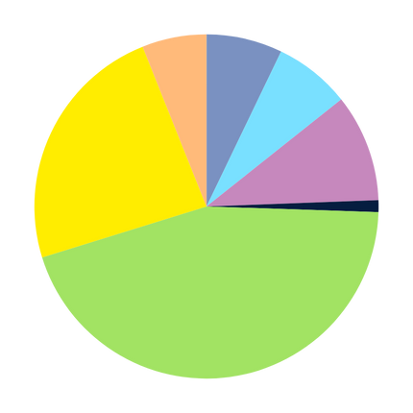


DBDI FINANCIAL PLAN
$1.42M
$1.67M
$1.683M
Partner Funding: 5-year total $25M
$2.37M
In-Kind AltaSea Operational Support: 5-year total $5M
$5.57M
$260k
In-Kind Partner Support: 5-year total $2.5M
Test Bed and Tenant Rent Income: 5-year total $2M
$10.48M
$5M
DBDI Initiative Planning Senior Staff: 5-year total $1.675M
DBDI Program Staffing: 5-year total $1.683M
$2M
LA Test Bed Staff: 5-year total $2.37M
Communications Staff: 5-year total $260k
per-year
Key DBDI Advisors: 5-year total $10.488M
DBDI Outreach, Engagement & Travel: 5-year total $5.57M
Every dollar invested accelerates global impact—partner with us to drive ocean solutions forward!
LA Test Bed Operations: 5-year total $1.42M
Staff Fringe & Benefits: 5- year total $1.497M

Slide 29
DBDI ADVISORY BOARD
AltaSea has begun development of a Global Advisory Board for the Deep Blue Decade Initiative. The Board will oversee DBDI development and help synergize activities across ocean communities, with subcommittees dedicated to each DBDI ocean community.
Global Blue Economy Development
·Dr. Sandra Whitehouse, Strategic Advisor, Ocean Conservancy
·Yannick Glemarec, President/Board Chair of Gold Standard
·David Albertani, Executive Director, Catalytic Finance Foundation
·Craig Cogut, Chairman, Pegasus Capital Advisors
·Patricia Purcell, United Nations Development Programme
Seaweed and Aquaculture Experts
·Dr. Sergey Nuzhdin, Seaweed Geneticist, Kelp Ark
·Dr. Dave Vaughan, Chief Scientist, Voyacy Regen
·Dr. Michael Roleda, Professor, University of the Philippines, Marine Science Institute
·Dr. Tony Michaels, Marine Biologist, Proteus Environmental
Renewable Energy and mCDR Experts
·Gaurav Sant, Founder, Equatic (mCDR)
·Inna Braverman, Founder/CEO, Eco Wave Power
·Tak Yokoo, Founder/CEO, Jozen Power (Hydrogen)
·Daniel Limonadi, Chief Systems Engineer, NASA/JPL
Workforce Development Experts
·Dr. Laura Rink, Heal the Bay
·Dr. Patricia Ramos, Dean of Academic Affairs, Santa Monica College
Regional Sub-Committee Representatives
·Indonesia: Ian Ralby, Gita Sabharwal, United Nations, Indonesia Resident Coordinator
·Jordan: Philippe Cousteau, Voyacy Regen; Carlos Duarte, Distinguished Professor, King Abdullah University of Science and Technology
·Tanzania & Tonga: To be determined

Slide 30
DBDI FINANCIAL PARTNERSHIPS
AltaSea has established relationships and experiences with a global network of funding partners and institutional investors that are looking for commercialization opportunities with impact.
A GLOBAL INVESTOR NETWORK
Brookfield Global Transition Fund II
Brookfield Catalytic Transition Fund
Blackstone Infrastructure Fund
Blackstone Credit & Insurance Fund
Subnational Climate Fund
Mitsubishi “MUFG”
Whitewood AIFM
European Investment Bank (EIB)
SUSI Partners
FinDev Canada
PENDING DBDI FUNDING PARTNERS
Grantham Foundation
Builders Initiative
United Nations Development Programme
Pegasus Capital Advisory
OceanX
Ocean Visions
Breakthrough Energy
Temasek Trust/Philanthropy Asia Alliance
The Laney And Pasha Thornton Foundation
1111 Foundation
Japan International Cooperation Agency (JICA)
French Development Agency (AFD)
U.S. International Development Finance Corporation
British International Investment (BII)
Foreign and Commonwealth Office (FCDO)
Global Fund for Coral Reefs
Pegasus Capital Advisors
Angeleno Group
UNDP and World Bank

Slide 31
Appendix D
KEY PARTNERS

Slide 32

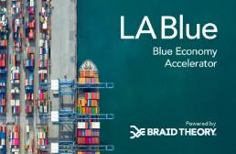
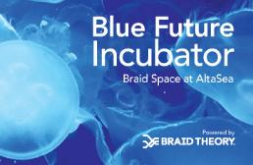
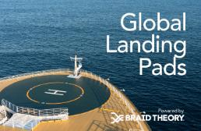
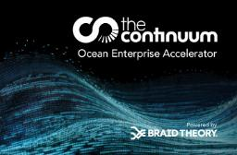
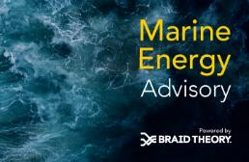
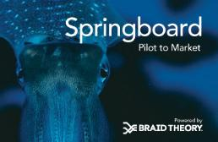

Braid Theory programs target entrepreneurs with the most promising solutions across all areas of the blue economy innovation ecosystem including enabling technologies.
Braid Theory is a vertically integrated venture advisory firm that supports science and engineering-led companies operating in the sustainable blue economy.
Braid Theory weaves together entrepreneurs, industry influencers, and corporate partners to accelerate the adoption of transformative technology, drive market growth, and create profitable collaborations.
High domain expertise.
Hybrid model of services.
Strategic consulting
Commercialization support
Acceleration programming
Event production
Access to capital
Pilot project coordination
Los Angeles | Barcelona | Singapore
90-day accelerator for startups working on solutions across all blue economy industry sectors.
Expert workshops, exclusive resources, mentorship, networking, and funding opportunities.
Stakeholder engagement and entrepreneur advisory services in North America, Europe, and Asia.
NOAA-funded accelerator programs supporting the commercialization of ocean data technologies.
Customer services supporting the advancement and adoption of marine energy solutions.
Customized pilot project design and deployment support for startups.
Celebrating Innovators Shaping the 22nd Century
Entrepreneurs showcase cutting-edge blue economy solutions
Industry leaders discover transformative technologies
Investors connect with ventures poised for sustainable growth

Slide 33
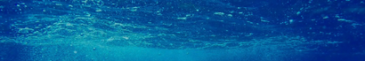
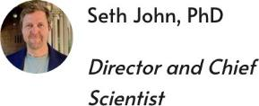
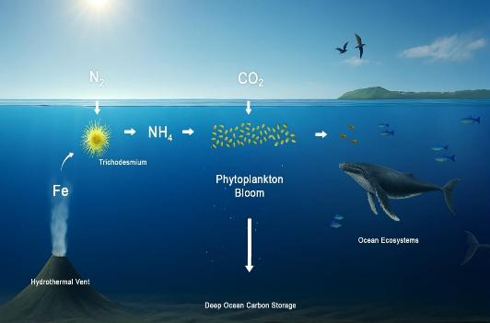
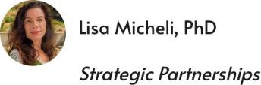

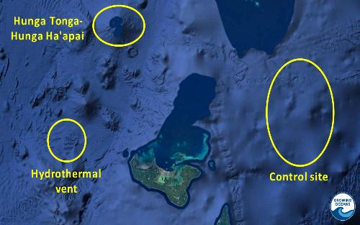
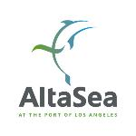

Growing Oceans
Scientific Research for Climate Solutions that Scale
Our Leadership Team
Mission
Mimicking how nature stimulates ocean photosynthesis.
Safe, durable, gigaton-scale marine carbon dioxide removal.
Revitalizing ocean ecosystems.
Research ‘toolbox’
Natural analog study of Tonga hydrothermal vents.
Biogoechemical profiling of South Pacific nitrogen-fixation.
Ecosystem impact measurements.
An AltaSea Initiative

Slide 34

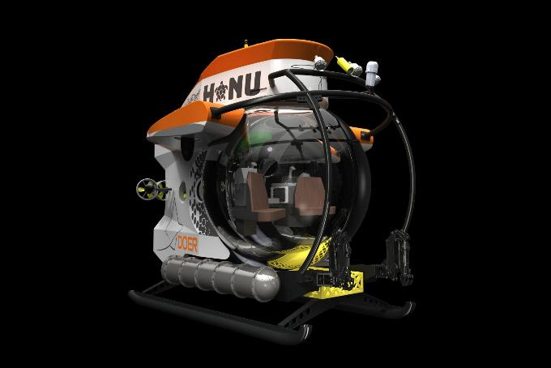
THE HONU INITIATIVE
A WHOLE NEW APPROACH TO OCEAN EXPLORATION
By 2030 activate 5 selected Mission Blue Hope Spot regions with this model to demonstrate nature positive solutions driven by the local communities and powered by collaboration. By deepening our knowledge about ocean health via direct exploration, innovation will follow with development of complementary sensors, tools, and coastal resilience strategies.
Collaboration with Alta Sea accelerates this effort, supporting initial operations on Pacific Coast and beyond. Altasea provides ideal testing facilities for research and development of new technologies. Altasea will serve as a home base for a pair of HONU submersibles in support of Hope Spots in the North Eastern Pacific.
02
HONU SUBS DEPLOYED IN 2026
DOERMARINE.COM

Slide 35
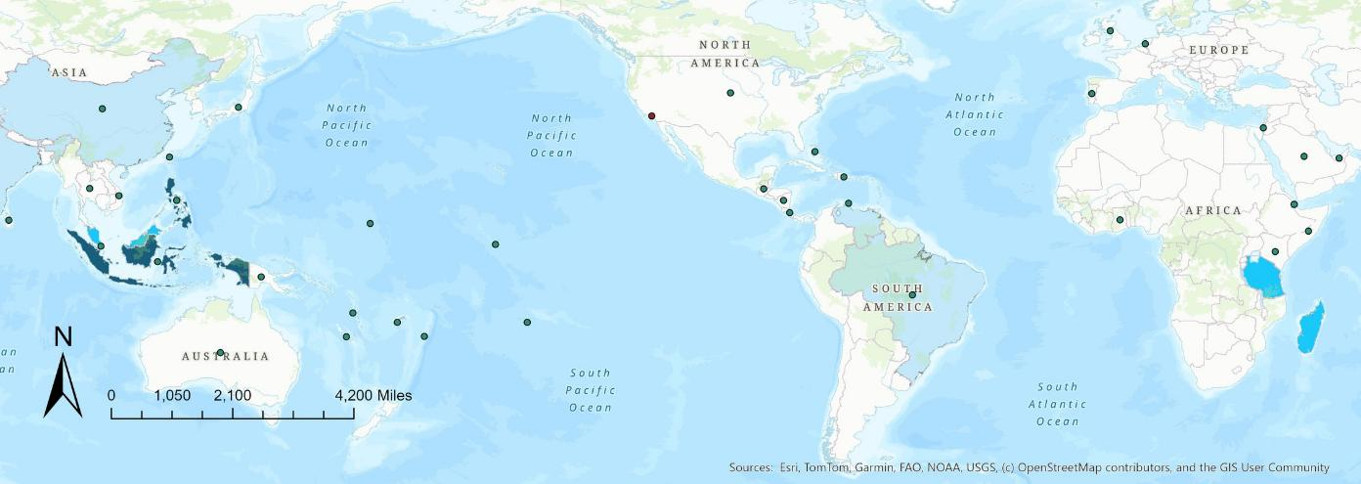
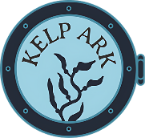


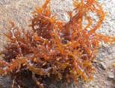


Kappaphycus (red algae) Seed Improvement
ACTION PLAN
Expand the Seedbank – Grow from 93 to roughly 1000 genetically diverse stocks.
Develop Breeding Program – Boost productivity by 30% within three years, enhance carrageenan quality, strengthen resistance to ice ice disease, and engage Cargill as a key partner.
Launch Trainee Exchange – Establish a collaborative program between the University
of Southern California and the University of Indonesia to build future expertise.
Kappaphycus farms worldwide use decayed, disease susceptible seeds.
Seed banking/breeding improvements can add value to the market and increase profitability for farmers.
Quality Marine Collectors worldwide are ready to seedbank and export to Kelp Ark.
Kelp Ark brings macroalgal and genetic expertise, a global partner network, and the ability to supply improved seedstock to boost farmer livelihoods via our LA breeding hub.
For more information, contact us at hayden@kelpark.org or check out our website www.kelpark.org.

Slide 36

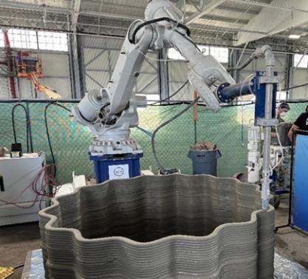
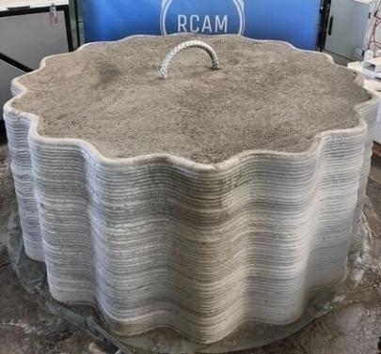
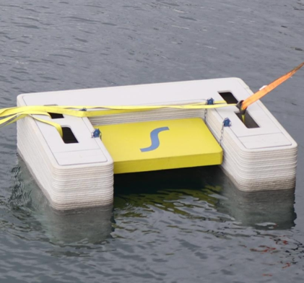

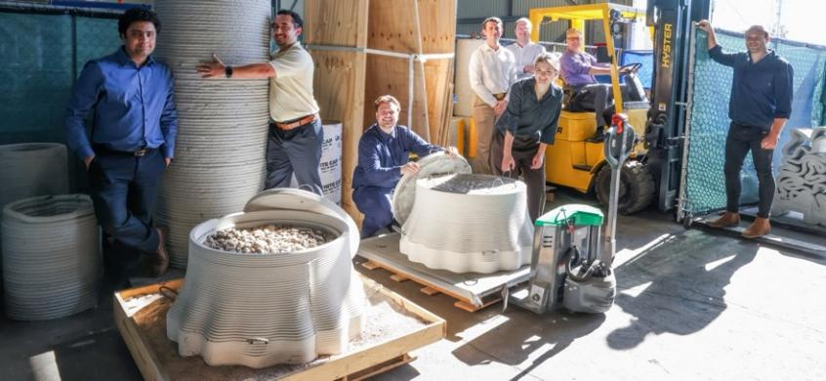
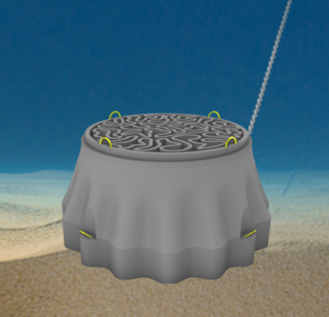
Mission: Sperra is establishing a new era of automated marine construction that delivers offshore energy and coastal resilience solutions worldwide.
Key Innovation:
3D Concrete Printing
Sperra uses 3DCP technology with local materials to radically reduce costs, minimize waste, and automate construction while ensuring superior structural integrity.
Product Portfolio
Floating solar and offshore wind anchors
Solar canal structures
Port infrastructure solutions
Subsea pumped hydro energy storage
36

Slide 37
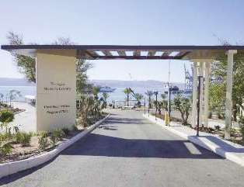



VOYACY REGEN PARTNERS WITH JORDAN TO LAUNCH FIRST OF ITS KIND REEF REGENERATION HUB
On June 9th at UNOC3, Voyacy Regen and The Kingdom of Jordan announced their partnership to launch a new Blue Technology Innovation Hub in Aqaba.
This Hub is a nexus of action implementing Voyacy’s multi-disciplinary solution
Voyacy and Jordan have mobilized a pioneering coral propagation farm and deployed a commercial scale 3D concrete print facility
The Aqaba initiative is bringing together leading Blue Tech players to demonstrate how technology will rebuild and maintain coral reefs at a commercial scale across the globe.
Aqaba Marine Park Innovation Hub
Coral Farm
Best-in-class 3D Printing Facility

Slide 38





CONTACT US
Terry Tamminen
TT@altasea.org
Jenny Krusoe
jkrusoe@altasea.org
AltaSea
2451 Signal Street, San Pedro CA 90731
www.altasea.org

